Slide 1

Chapter 5
Peer-to-Peer Protocols and Data Link Layer
PART I: Peer-to-Peer Protocols
Peer-to-Peer Protocols and Service Models
ARQ Protocols and Reliable Data Transfer
Flow Control
Timing Recovery
TCP Reliable Stream Service & Flow Control

Slide 2
Chapter 5
Peer-to-Peer Protocols and Data Link Layer
PART II: Data Link Controls
Framing
Point-to-Point Protocol
High-Level Data Link Control
Link Sharing Using Statistical Multiplexing

Slide 3
Chapter Overview
Peer-to-Peer protocols: many protocols involve the interaction between two peers
  Service Models are discussed & examples given
  Detailed discussion of ARQ provides example of development of peer-to-peer protocols
  Flow control, TCP reliable stream, and timing recovery
Data Link Layer
  Framing
  PPP & HDLC protocols
  Statistical multiplexing for link sharing

Slide 4
Chapter 5
Peer-to-Peer Protocols and Data Link Layer
Peer-to-Peer Protocols and Service Models

Slide 5
Peer-to-Peer Protocols
●  
●  
Peer-to-Peer processes execute layer-n protocol to provide service to layer-(n+1)
n + 1 peer process
n + 1 peer process
SDU
SDU
Layer-(n+1) peer calls layer-n and passes Service Data Units (SDUs) for transfer
PDU
n peer process
n peer process
Layer-n peers exchange Protocol Data Units (PDUs) to effect transfer
n – 1 peer process
n – 1 peer process
Layer-n delivers SDUs to destination layer-(n+1) peer
●  
●  

Slide 6
Service Models
The service model specifies the information transfer service layer-n provides to layer-(n+1)
The most important distinction is whether the service is:
  Connection-oriented
  Connectionless
Service model possible features:
  Arbitrary message size or structure
  Sequencing and Reliability
  Timing, Pacing, and Flow control
  Multiplexing
  Privacy, integrity, and authentication

Slide 7
Connection-Oriented Transfer Service
Connection Establishment
  Connection must be established between layer-(n+1) peers
  Layer-n protocol must: Set initial parameters, e.g. sequence numbers; and Allocate resources, e.g. buffers
Message transfer phase
  Exchange of SDUs
Disconnect phase
Example: TCP, PPP
n + 1 peer process
send
n + 1 peer process
receive
SDU
Layer n connection-oriented service
SDU

Slide 8
Connectionless Transfer Service
No Connection setup, simply send SDU
Each message send independently
Must provide all address information per message
Simple & quick
Example: UDP, IP
n + 1 peer process
send
n + 1 peer process
receive
SDU
Layer n connectionless service

Slide 9
Message Size and Structure
What message size and structure will a service model accept?
  Different services impose restrictions on size & structure of data it will transfer
  Single bit? Block of bytes? Byte stream?
  Ex: Transfer of voice mail = 1 long message
  Ex: Transfer of voice call = byte stream
1 voice mail= 1 message = entire sequence of speech samples
(a)
1 call = sequence of 1-byte messages
(b)

Slide 10
Segmentation & Blocking
To accommodate arbitrary message size, a layer may have to deal with messages that are too long or too short for its protocol
Segmentation & Reassembly: a layer breaks long messages into smaller blocks and reassembles these at the destination
Blocking & Unblocking: a layer combines small messages into bigger blocks prior to transfer
1 long message
2 or more short messages
2 or more blocks
1 block

Slide 11
Reliability & Sequencing
Reliability: Are messages or information stream delivered error-free and without loss or duplication?
Sequencing: Are messages or information stream delivered in order?
ARQ protocols combine error detection, retransmission, and sequence numbering to provide reliability & sequencing
Examples: TCP and HDLC

Slide 12
Pacing and Flow Control
Messages can be lost if receiving system does not have sufficient buffering to store arriving messages
If destination layer-(n+1) does not retrieve its information fast enough, destination layer-n buffers may overflow
Pacing & Flow Control provide backpressure mechanisms that control transfer according to availability of buffers at the destination
Examples: TCP and HDLC

Slide 13
Timing
Applications involving voice and video generate units of information that are related temporally
Destination application must reconstruct temporal relation in voice/video units
Network transfer introduces delay & jitter
Timing Recovery protocols use timestamps & sequence numbering to control the delay & jitter in delivered information
Examples: RTP & associated protocols in Voice over IP

Slide 14
Multiplexing
Multiplexing enables multiple layer-(n+1) users to share a layer-n service
A multiplexing tag is required to identify specific users at the destination
Examples: UDP, IP

Slide 15
Privacy, Integrity, & Authentication
Privacy: ensuring that information transferred cannot be read by others
Integrity: ensuring that information is not altered during transfer
Authentication: verifying that sender and/or receiver are who they claim to be
Security protocols provide these services and are discussed in Chapter 11
Examples: IPSec, SSL

Slide 16
End-to-End vs. Hop-by-Hop
A service feature can be provided by implementing a protocol
  end-to-end across the network
  across every hop in the network
Example:
  Perform error control at every hop in the network or only between the source and destination?
  Perform flow control between every hop in the network or only between source & destination?
We next consider the tradeoffs between the two approaches

Slide 17
Error control in Data Link Layer
Packets
Packets
Data Link operates over wire-like, directly-connected systems
Frames can be corrupted or lost, but arrive in order
Data link performs error-checking & retransmission
Ensures error-free packet transfer between two systems
(a)
Data link
layer
Data link
layer
A
Frames
Physical
layer
B
Physical
layer
(b)
1
1
2
2
1
2
3
2
1
1
2
3
2
1
Medium
2
A
B
1
1
Physical layer entity
2
Data link layer entity
3
Network layer entity

Slide 18
Error Control in Transport Layer
Transport layer protocol (e.g. TCP) sends segments across network and performs end-to-end error checking & retransmission
Underlying network is assumed to be unreliable
Messages
Messages
Transport
layer
Segments
Transport
layer
Network
layer
Network
layer
Network
layer
Network
layer
Data link
layer
Data link
layer
Data link
layer
Data link
layer
End system
A
End system
B
Physical
layer
Physical
layer
Physical
layer
Physical
layer
Network

Slide 19
Segments can experience long delays, can be lost, or arrive out-of-order because packets can follow different paths across network
End-to-end error control protocol more difficult
1
2
3
2
1
C
2
2
1
1
End System
α
1
1
End System
β
1
2
2
2
4
3
2
1
1
2
3
2
1
1
2
3
2
1
1
2
3
4
Medium
2
A
B
1
Network
3
Network layer entity
4
Transport layer entity

Slide 20
End-to-End Approach Preferred
Hop-by-hop
Hop-by-hop cannot ensure E2E correctness
Data
Data
Data
Data
1
2
3
4
5
Faster recovery
ACK/NAK
ACK/NAK
ACK/NAK
ACK/NAK
Simple inside the network
End-to-end
ACK/NAK
More scalable if complexity at the edge
1
2
3
4
5
Data
Data
Data
Data

Slide 21
Chapter 5
Peer-to-Peer Protocols and Data Link Layer
ARQ Protocols and Reliable Data Transfer

Slide 22
Automatic Repeat Request (ARQ)
Purpose: to ensure a sequence of information packets is delivered in order and without errors or duplications despite transmission errors & losses
We will look at:
  Stop-and-Wait ARQ
  Go-Back N ARQ
  Selective Repeat ARQ
Basic elements of ARQ:
  Error-detecting code with high error coverage
  ACKs (positive acknowledgments
  NAKs (negative acknowlegments)
  Timeout mechanism

Slide 23
Stop-and-Wait ARQ
Transmit a frame, wait for ACK
Packet
Error-free
packet
Information frame
Transmitter
(Process A)
Receiver
(Process B)
Timer set after each frame transmission
Control frame
Header
CRC
Information
packet
Header
CRC
Information frame
Control frame: ACKs

Slide 24
Need for Sequence Numbers
(a) Frame 1 lost
Time-out
Time
A
Frame
0
Frame
1
Frame
1
Frame
2
B
ACK
ACK
(b) ACK lost
Time-out
Time
A
Frame
0
Frame
1
Frame
1
Frame
2
ACK
ACK
ACK
B
  In cases (a) & (b) the transmitting station A acts the same way
  But in case (b) the receiving station B accepts frame 1 twice
  Question: How is the receiver to know the second frame is also frame 1?
  Answer: Add frame sequence number in header
  S_{last} is sequence number of most recent transmitted frame

Slide 25
Sequence Numbers
(c) Premature Time-out
Time-out
Time
A
Frame
0
Frame
0
Frame
1
Frame
2
ACK
ACK
B
  The transmitting station A misinterprets duplicate ACKs
  Incorrectly assumes second ACK acknowledges Frame 1
  Question: How is the receiver to know second ACK is for frame 0?
  Answer: Add frame sequence number in ACK header
  R_{next} is sequence number of next frame expected by the receiver
  Implicitly acknowledges receipt of all prior frames

Slide 26
1-Bit Sequence Numbering Suffices
0 1
0 1
0 1
0 1
0 1
0 1
0 1
0 1
S_{last}
R_{next}
Timer
Transmitter A
S_{last}
Receiver B
R_{next}
Global State:
(S_{last}, R_{next})
Error-free frame 0
arrives at receiver
(0,0)
(0,1)
ACK for
frame 0
arrives at
transmitter
ACK for
frame 1
arrives at
transmitter
Error-free frame 1
arrives at receiver
(1,0)
(1,1)

Slide 27
Stop-and-Wait ARQ
Transmitter
Ready state
Await request from higher layer for packet transfer
When request arrives, transmit frame with updated S_{last} and CRC
Go to Wait State
Wait state
Wait for ACK or timer to expire; block requests from higher layer
If timeout expires
  retransmit frame and reset timer
If ACK received:
  If sequence number is incorrect or if errors detected: ignore ACK
  If sequence number is correct (R_{next} = S_{last} +1): accept frame, go to Ready state
Receiver
Always in Ready State
Wait for arrival of new frame
When frame arrives, check for errors
If no errors detected and sequence number is correct (S_{last}=R_{next}), then
  accept frame,
  update R_{next},
  send ACK frame with R_{next},
  deliver packet to higher layer
If no errors detected and wrong sequence number
  discard frame
  send ACK frame with R_{next}
If errors detected
  discard frame

Slide 28
Applications of Stop-and-Wait ARQ
IBM Binary Synchronous Communications protocol (Bisync): character-oriented data link control
Xmodem: modem file transfer protocol
Trivial File Transfer Protocol (RFC 1350): simple protocol for file transfer over UDP

Slide 29
Stop-and-Wait Efficiency
Last frame bit enters channel
ACK arrives
First frame bit enters channel
Channel idle while transmitter waits for ACK
t
A
B
t
First frame bit arrives at receiver
Receiver processes frame and
prepares ACK
Last frame bit arrives at receiver
10000 bit frame @ 1 Mbps takes 10 ms to transmit
If wait for ACK = 1 ms, then efficiency = 10/11= 91%
If wait for ACK = 20 ms, then efficiency =10/30 = 33%

Slide 30
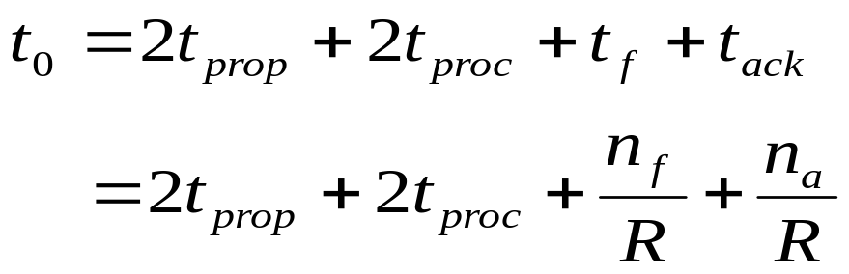
Stop-and-Wait Model
      t₀ = total time to transmit 1 frame
A
t_{proc}
B
t_{prop}
frame
t_{f} time
t_{proc}
t_{ack}
t_{prop}
bits/info frame
bits/ACK frame
channel transmission rate

Slide 31
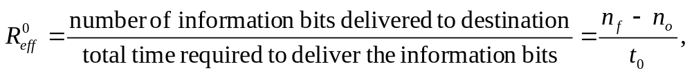
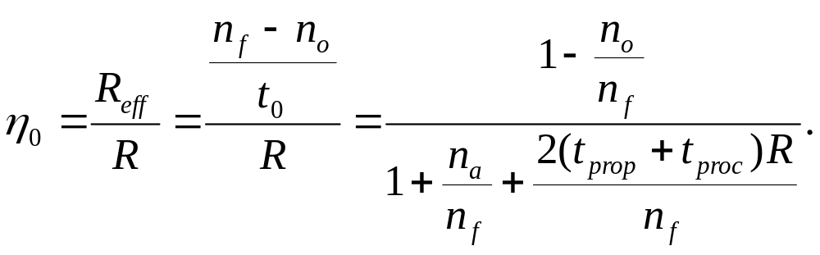
S&W Efficiency on Error-free channel
Effective transmission rate:
bits for header & CRC
Transmission efficiency:
Effect of
frame overhead
Effect of
Delay-Bandwidth Product
Effect of
ACK frame

Slide 32
Example: Impact of Delay-Bandwidth Product
n_{f}=1250 bytes = 10000 bits, n_{a}=n_{o}=25 bytes = 200 bits
2xDelayxBW Efficiency | 1 ms 200 km | 10 ms 2000 km | 100 ms 20000 km | 1 sec 200000 km
1 Mbps | 10³ 88% | 10⁴ 49% | 10⁵ 9% | 10⁶ 1%
1 Gbps | 10⁶ 1% | 10⁷ 0.1% | 10⁸ 0.01% | 10⁹ 0.001%
Stop-and-Wait does not work well for very high speeds or long propagation delays

Slide 33
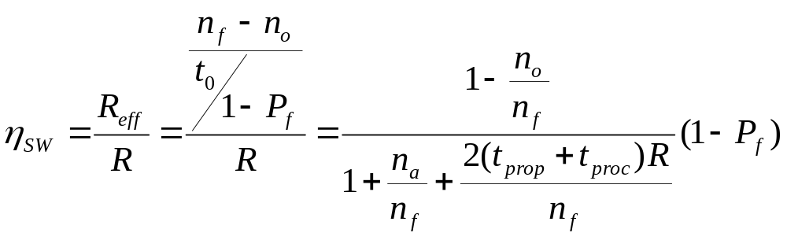
S&W Efficiency in Channel with Errors
Let 1 – P_{f} = probability frame arrives w/o errors
Avg. # of transmissions to first correct arrival is then 1/ (1–P_{f} )
“If 1-in-10 get through without error, then avg. 10 tries to success”
Avg. Total Time per frame is then t₀/(1 – P_{f})
Effect of frame loss

Slide 34
Example: Impact Bit Error Rate
n_{f}=1250 bytes = 10000 bits, n_{a}=n_{o}=25 bytes = 200 bits
Find efficiency for random bit errors with p=0, 10⁻⁶, 10⁻⁵, 10⁻⁴
1 – P_{f} Efficiency | 0 | 10⁻⁶ | 10⁻⁵ | 10⁻⁴
1 Mbps & 1 ms | 1 88% | 0.99 86.6% | 0.905 79.2% | 0.368 32.2%
Bit errors impact performance as n_{f}p approach 1

Slide 35
Go-Back-N
Improve Stop-and-Wait by not waiting!
Keep channel busy by continuing to send frames
Allow a window of up to W_{s} outstanding frames
Use m-bit sequence numbering
If ACK for oldest frame arrives before window is exhausted, we can continue transmitting
If window is exhausted, pull back and retransmit all outstanding frames
Alternative: Use timeout

Slide 36
Go-Back-N ARQ
Go-Back-4:
4 frames are outstanding; so go back 4
fr
0
fr
1
fr
2
fr
3
fr
4
fr
5
fr
6
fr
3
fr
4
fr
5
fr
6
fr
7
fr
8
fr
9
Time
A
B
ACK1
ACK2
ACK3
out of sequence frames
ACK4
ACK5
ACK6
ACK7
ACK8
ACK9
R_{next} 0 1 2 3 3 4 5 6 7 8 9
  Frame transmission are pipelined to keep the channel busy
  Frame with errors and subsequent out-of-sequence frames are ignored
  Transmitter is forced to go back when window of 4 is exhausted

Slide 37
Window size long enough to cover round trip time
Time-out expires
Stop-and-Wait ARQ
Time
fr
0
fr
0
fr
1
A
B
Receiver is looking for R_{next}=0
ACK1
Go-Back-N ARQ
Four frames are outstanding; so go back 4
fr
0
fr
1
fr
2
fr
3
fr
0
fr
1
fr
2
fr
3
fr
4
fr
5
fr
6
Time
A
B
Receiver is looking for R_{next}=0
Out-of-sequence frames
ACK1
ACK2
ACK3
ACK4
ACK5
ACK6

Slide 38
Go-Back-N with Timeout
Problem with Go-Back-N as presented:
  If frame is lost and source does not have frame to send, then window will not be exhausted and recovery will not commence
Use a timeout with each frame
  When timeout expires, resend all outstanding frames

Slide 39
Go-Back-N Transmitter & Receiver
Transmitter
Receiver
Send Window
Receive Window
...
Frames
transmitted
and ACKed
S_{last}
S_{recent}
S_{last}+W_{s}-1
Buffers
Frames
received
R_{next}
oldest un-ACKed frame
Timer
S_{last}
Timer
S_{last}+1
Receiver will only accept
a frame that is error-free and
that has sequence number R_{next}
When such frame arrives R_{next} is incremented by one, so the receive window slides forward by one
...
S_{recent}
most recent transmission
Timer
...
S_{last}+W_{s}-1
max Seq # allowed

Slide 40
Sliding Window Operation
Transmitter
Send Window
m-bit Sequence Numbering
...
Frames
transmitted
and ACKed
0
S_{last}
S_{recent}
S_{last}+W_{s}-1
2^{m} – 1
1
2
Transmitter waits for error-free ACK frame with sequence number S_{last}
When such ACK frame arrives, S_{last} is incremented by one, and the send window slides forward by one
S_{last}
send
window
i
i + W_{s} – 1
i + 1

Slide 41
Maximum Allowable Window Size is W_{s} = 2^{m}-1
M = 2² = 4, Go-Back - 4:
Transmitter goes back 4
fr
0
fr
1
fr
2
fr
3
fr
0
fr
1
fr
2
fr
3
Time
A
B
ACK1
ACK2
ACK3
ACK
0
Receiver has R_{next}= 0, but it does not know whether its ACK for frame 0 was received, so it does not know whether this is the old frame 0 or a new frame 0
R_{next} 0 1 2 3 0
M = 2² = 4, Go-Back-3:
Transmitter goes back 3
fr
0
fr
1
fr
2
fr
0
fr
1
fr
2
Time
A
B
ACK1
ACK2
ACK3
Receiver has R_{next}= 3 , so it rejects the old frame 0
R_{next} 0 1 2 3

Slide 42
ACK Piggybacking in Bidirectional GBN
Transmitter
S^{A}_{recent} R^{A} _{next}
Receiver
Receiver
Transmitter
S^{B}_{recent} R^{B} _{next}
“A” Receive Window
“B” Receive Window
R^{A} _{next}
R^{B} _{next}
“A” Send Window
“B” Send Window
...
...
S^{A} _{last}
S^{A} _{last}+W^{A} _{s}-1
S^{B} _{last}
S^{B} _{last}+W^{B} _{s}-1
Buffers
Buffers
Timer
S^{A} _{last}
Timer
S^{B} _{last}
Timer
S^{A} _{last}+1
Note: Out-of-sequence error-free frames discarded after R_{next} examined
Timer
S^{B}_{last}+1
...
...
Timer
S^{A}_{recent}
Timer
S^{B}_{recent}
...
...
Timer
S^{A} _{last}+W^{A} _{s}-1
Timer
S^{B} _{last}+W^{B} _{s}-1

Slide 43
Applications of Go-Back-N ARQ
HDLC (High-Level Data Link Control): bit-oriented data link control
V.42 modem: error control over telephone modem links

Slide 44
Required Timeout & Window Size
T_{out}
T_{proc}
T_{prop}
T_{f}
T_{f}
T_{prop}
Timeout value should allow for:
  Two propagation times + 1 processing time: 2 T_{prop} + T_{proc}
  A frame that begins transmission right before our frame arrives T_{f}
  Next frame carries the ACK, T_{f}
W_{s} should be large enough to keep channel busy for T_{out}

Slide 45
Required Window Size for
Delay-Bandwidth Product
Frame = 1250 bytes =10,000 bits, R = 1 Mbps
2(t_{prop} + t_{proc}) | 2 x Delay x BW | Window
1 ms | 1000 bits | 1
10 ms | 10,000 bits | 2
100 ms | 100,000 bits | 11
1 second | 1,000,000 bits | 101

Slide 46

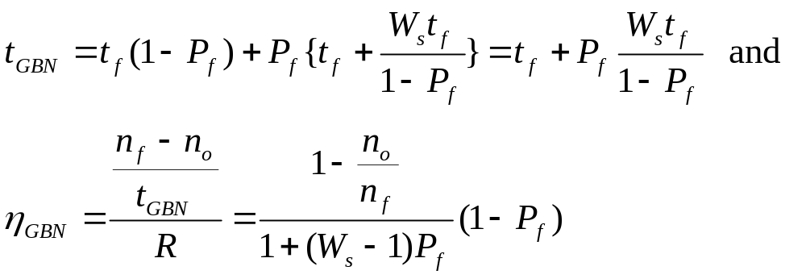
Efficiency of Go-Back-N
GBN is completely efficient, if W_{s} large enough to keep channel busy, and if channel is error-free
Assume P_{f} frame loss probability, then time to deliver a frame is:
  t_{f} if first frame transmission succeeds (1 – P_{f} )
  T_{f} + W_{s}t_{f} /(1-P_{f}) if the first transmission does not succeed P_{f}
Delay-bandwidth product determines W_{s}

Slide 47
Example: Impact Bit Error Rate on GBN
n_{f}=1250 bytes = 10000 bits, n_{a}=n_{o}=25 bytes = 200 bits
Compare S&W with GBN efficiency for random bit errors with p = 0, 10⁻⁶, 10⁻⁵, 10⁻⁴ and R = 1 Mbps & 100 ms
1 Mbps x 100 ms = 100000 bits = 10 frames → Use W_{s} = 11
Efficiency | 0 | 10⁻⁶ | 10⁻⁵ | 10⁻⁴
S&W | 8.9% | 8.8% | 8.0% | 3.3%
GBN | 98% | 88.2% | 45.4% | 4.9%
Go-Back-N significant improvement over Stop-and-Wait for large delay-bandwidth product
Go-Back-N becomes inefficient as error rate increases

Slide 48
Selective Repeat ARQ
Go-Back-N ARQ inefficient because multiple frames are resent when errors or losses occur
Selective Repeat retransmits only an individual frame
  Timeout causes individual corresponding frame to be resent
  NAK causes retransmission of oldest un-acked frame
Receiver maintains a receive window of sequence numbers that can be accepted
  Error-free, but out-of-sequence frames with sequence numbers within the receive window are buffered
  Arrival of frame with R_{next} causes window to slide forward by 1 or more

Slide 49
Selective Repeat ARQ
fr
0
fr
1
fr
2
fr
3
fr
4
fr
5
fr
6
fr
2
fr
7
fr
8
fr
9
fr
10
fr
11
fr
12
Time
A
B
ACK1
ACK2
NAK2
ACK2
ACK2
ACK2
ACK7
ACK8
ACK9
ACK10
ACK11
ACK12

Slide 50
Selective Repeat ARQ
Transmitter
Receiver
Send Window
Receive Window
...
Frames
transmitted
and ACKed
Frames
received
S_{last}
S_{recent}
S_{last}+ W_{s}-1
R_{next}
R_{next} + W_{r}-1
Buffers
Buffers
Timer
S_{last}
R_{next}+ 1
Timer
S_{last}+ 1
R_{next}+ 2
...
S_{recent}
...
Timer
R_{next}+ W_{r}- 1
max Seq # accepted
...
S_{last}+ W_{s} - 1

Slide 51
Send & Receive Windows
Transmitter
Receiver
0
0
2^{m}-1
1
2^{m}-1
1
2
2
R_{next}
S_{last}
send
window
receive
window
j
i
i
i + W_{s} – 1
i + 1
j + W_{r} – 1
Moves k forward when ACK
arrives with R_{next} = S_{last} + k
k = 1, …, W_{s}-1
Moves forward by 1 or more when frame arrives with Seq. # = R_{next}

Slide 52
What size W_{s} and W_{r} allowed?
Example: M=2²=4, W_{s}=3, W_{r}=3
Frame 0 resent
Send Window
{0,1,2}
{1,2}
{2}
{.}
A
fr0
fr1
fr2
fr0
Time
B
Receive Window
ACK1
ACK2
ACK3
{0,1,2}
{1,2,3}
{2,3,0}
{3,0,1}
Old frame 0 accepted as a
new frame because it falls
in the receive window

Slide 53
W_{s} + W_{r} = 2^{m} is maximum allowed
Example: M=2²=4, W_{s}=2, W_{r}=2
Frame 0 resent
Send Window
{0,1}
{1}
{.}
A
fr0
fr1
fr0
Time
B
Receive Window
ACK1
ACK2
{0,1}
{1,2}
{2,3}
Old frame 0 rejected because it falls outside the receive window

Slide 54
Why W_{s} + W_{r} = 2^{m} works
Transmitter sends frames 0 to Ws-1; send window empty
All arrive at receiver
All ACKs lost
Receiver window starts at {0, …, W_{r}}
Window slides forward to {W_{s},…,W_{s}+W_{r}-1}
Receiver rejects frame 0 because it is outside receive window
Transmitter resends frame 0
0
0
2^{m}-1
1
2^{m}-1
1
S_{last}
W_{s} +W_{r}-1
2
2
receive
window
R_{next}
W_{s}
send
window
W_{s}-1

Slide 55
Applications of Selective Repeat ARQ
TCP (Transmission Control Protocol): transport layer protocol uses variation of selective repeat to provide reliable stream service
Service Specific Connection Oriented Protocol: error control for signaling messages in ATM networks

Slide 56
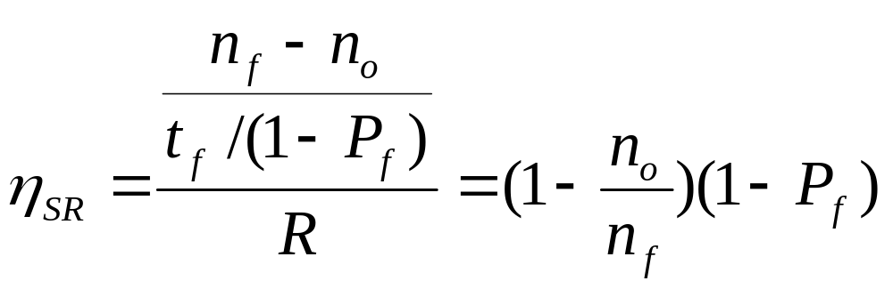
Efficiency of Selective Repeat
Assume P_{f} frame loss probability, then number of transmissions required to deliver a frame is:
  t_{f /} (1-P_{f})

Slide 57
Example: Impact Bit Error Rate on Selective Repeat
n_{f}=1250 bytes = 10000 bits, n_{a}=n_{o}=25 bytes = 200 bits
Compare S&W, GBN & SR efficiency for random bit errors with p=0, 10⁻⁶, 10⁻⁵, 10⁻⁴ and R= 1 Mbps & 100 ms
Efficiency | 0 | 10⁻⁶ | 10⁻⁵ | 10⁻⁴
S&W | 8.9% | 8.8% | 8.0% | 3.3%
GBN | 98% | 88.2% | 45.4% | 4.9%
SR | 98% | 97% | 89% | 36%
Selective Repeat outperforms GBN and S&W, but efficiency drops as error rate increases

Slide 58
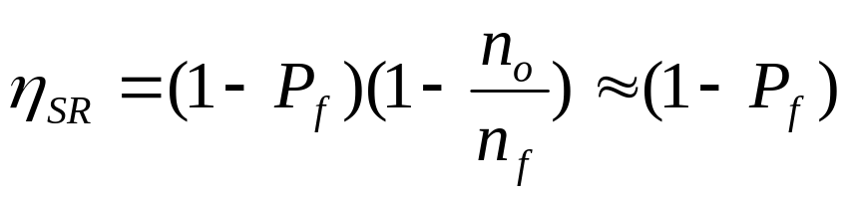
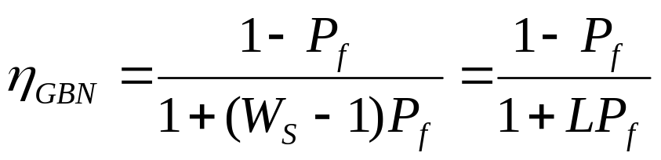
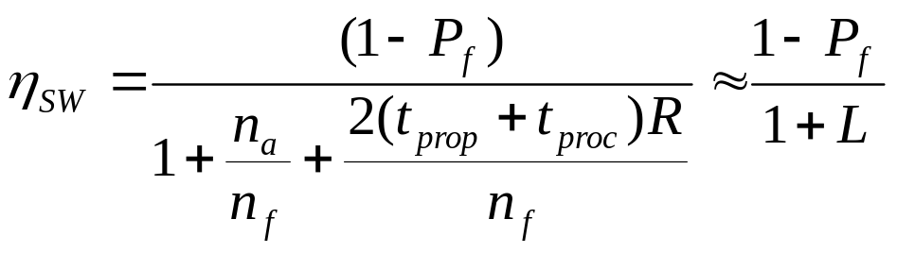
Comparison of ARQ Efficiencies
Assume n_{a} and n_{o} are negligible relative to n_{f}, and
L = 2(t_{prop}+t_{proc})R/n_{f} =(W_{s}-1), then
Selective-Repeat:
Go-Back-N:
For P_{f}≈0, SR & GBN same
For P_{f}→1, GBN & SW same
Stop-and-Wait:

Slide 59
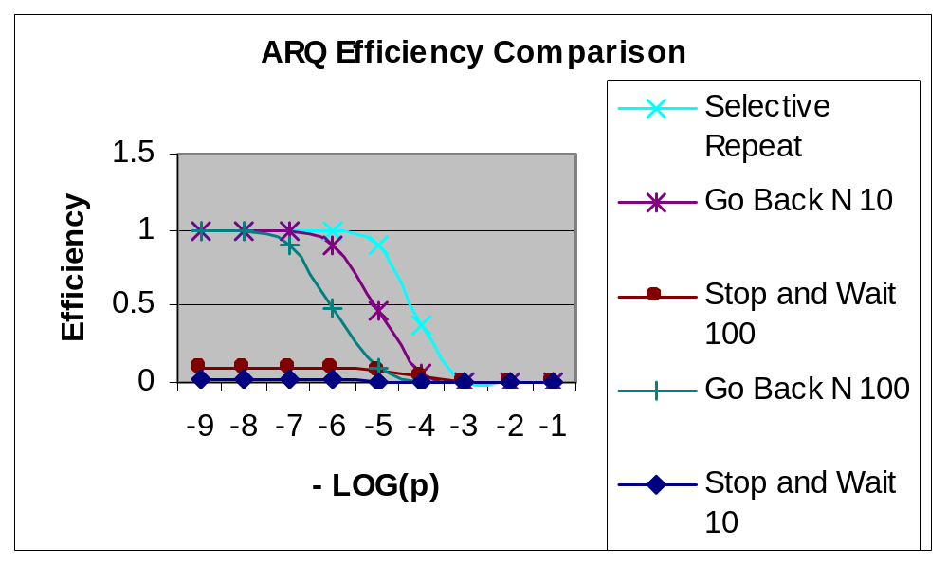
ARQ Efficiencies
10⁻⁹ 10⁻⁸ 10⁻⁷ 10⁻⁶ 10⁻⁵ 10⁻⁴ 10⁻³ 10⁻² 10⁻¹
p
Delay-Bandwidth product = 10, 100

Slide 60
Chapter 5
Peer-to-Peer Protocols and Data Link Layer
Flow Control

Slide 61
Flow Control
buffer fill
Information frame
Transmitter
Receiver
Control frame
Receiver has limited buffering to store arriving frames
Several situations cause buffer overflow
  Mismatch between sending rate & rate at which user can retrieve data
  Surges in frame arrivals
Flow control prevents buffer overflow by regulating rate at which source is allowed to send information

Slide 62
X ON / X OFF
threshold
Information frame
Transmitter
Receiver
Transmit
X OFF
Transmit
Time
A
on
off
on
off
B
Time
2T_{prop}
Threshold must activate OFF signal while 2 T_{prop} R bits still remain in buffer

Slide 63
Window Flow Control
Return of permits
t_{cycle}
A
Time
B
Time
Sliding Window ARQ method with W_{s} equal to buffer available
  Transmitter can never send more than W_{s} frames
ACKs that slide window forward can be viewed as permits to transmit more
Can also pace ACKs as shown above
  Return permits (ACKs) at end of cycle regulates transmission rate
Problems using sliding window for both error & flow control
  Choice of window size
  Interplay between transmission rate & retransmissions
  TCP separates error & flow control

Slide 64
Chapter 5
Peer-to-Peer Protocols and Data Link Layer
Timing Recovery

Slide 65
Timing Recovery for Synchronous Services
Synchronous source sends periodic information blocks
Network output not periodic
Network
Applications that involve voice, audio, or video can generate a synchronous information stream
Information carried by equally-spaced fixed-length packets
Network multiplexing & switching introduces random delays
  Packets experience variable transfer delay
  Jitter (variation in inter packet arrival times) also introduced
Timing recovery re-establishes the synchronous nature of the stream

Slide 66
Introduce Playout Buffer
Packet Arrivals
Packet Playout
Playout
Buffer
Packet Arrivals
Sequence numbers help order packets
Packet Playout
T_{max}
Delay first packet by maximum network delay
All other packets arrive with less delay
Playout packet uniformly thereafter

Slide 67
Arrival times
Time
Playout clock must be synchronized to transmitter clock
Send
times
Receiver too slow;
buffer fills and overflows
Playout
times
T_{playout}
time
Receiver too fast
buffer starvation
Receiver speed
just right
Time
Time
Many late
packets
T_{playout}
time
T_{playout}
time

Slide 68
Clock Recovery
Timestamps inserted in packet payloads indicate when info was produced
Buffer for information blocks
Playout
command
Error
signal
+
Smoothing
filter
Adjust
frequency
Add
t₄
t₃
t₂
t₁
Recovered
clock
-
Timestamps
Counter
Counter attempts to replicate transmitter clock
Frequency of counter is adjusted according to arriving timestamps
Jitter introduced by network causes fluctuations in buffer & in local clock

Slide 69
Synchronization to a Common Clock
Transmitter
Receiver
M
M
f_{s}
Network
f_{r}
M=#ticks in local clock
In time that net clock does N ticks
Δf=f_{n}-f_{s}=f_{n}-(M/N)f_{n}
f_{n}
f_{n}/f_{s}=N/M
N ticks
N ticks
f_{r}=f_{n}-Δf
Network clock
Clock recovery simple if a common clock is available to transmitter & receiver
  E.g. SONET network clock; Global Positioning System (GPS)
Transmitter sends Δf of its frequency & network frequency
Receiver adjusts network frequency by Δf
Packet delay jitter can be removed completely

Slide 70
Example: Real-Time Protocol
RTP (RFC 1889) designed to support real-time applications such as voice, audio, video
RTP provides means to carry:
  Type of information source
  Sequence numbers
  Timestamps
Actual timing recovery must be done by higher layer protocol
  MPEG2 for video, MP3 for audio

Slide 71
Chapter 5
Peer-to-Peer Protocols and Data Link Layer
TCP Reliable Stream Service & Flow Control

Slide 72
TCP Reliable Stream Service
TCP transfers byte stream in order, without errors or duplications
Application Layer writes bytes into send buffer through socket
Application Layer reads bytes from receive buffer through socket
Write 45 bytes
Write 15 bytes
Write 20 bytes
Read 40 bytes
Read 40 bytes
Application layer
Transport layer
Segments
Transmitter
Receiver
Send buffer
Receive buffer
ACKs

Slide 73
TCP ARQ Method
TCP uses Selective Repeat ARQ
  Transfers byte stream without preserving boundaries
Operates over best effort service of IP
  Packets can arrive with errors or be lost
  Packets can arrive out-of-order
  Packets can arrive after very long delays
  Duplicate segments must be detected & discarded
  Must protect against segments from previous connections
Sequence Numbers
  Seq. # is number of first byte in segment payload
  Very long Seq. #s (32 bits) to deal with long delays
  Initial sequence numbers negotiated during connection setup (to deal with very old duplicates)
  Accept segments within a receive window

Slide 74
Transmitter
Receiver
Send Window
Receive Window
S_{last} + W_{a}-1
R_{last}
R_{last} + W_{R} – 1
...
...
...
octets
transmitted
& ACKed
R_{next}
R_{new}
S_{last}
S_{recent}
S_{last} + W_{s} – 1
S_{last} oldest unacknowledged byte
S_{recent} highest-numbered transmitted byte
S_{last}+W_{a}-1 highest-numbered byte that can be transmitted
S_{last}+W_{s}-1 highest-numbered byte that can be accepted from the application
R_{last} highest-numbered byte not yet read by the application
R_{next} next expected byte
R_{new} highest numbered byte received correctly
R_{last}+W_{R}-1 highest-numbered byte that can be accommodated in receive buffer

Slide 75
TCP Connections
TCP Connection
  One connection each way
  Identified uniquely by Send IP Address, Send TCP Port #, Receive IP Address, Receive TCP Port #
Connection Setup with Three-Way Handshake
  Three-way exchange to negotiate initial Seq. #’s for connections in each direction
Data Transfer
  Exchange segments carrying data
Graceful Close
  Close each direction separately

Slide 76
Three Phases of TCP Connection
Host A
SYN, Seq_no = x
Host B
Three-way Handshake
SYN, Seq_no = y, ACK, Ack_no = x+1
Seq_no = x+1, ACK, Ack_no = y+1
Data Transfer
FIN, Seq_no = w
ACK, Ack_no = w+1
Graceful Close
Data Transfer
FIN, Seq_no = z
ACK, Ack_no = z+1

Slide 77
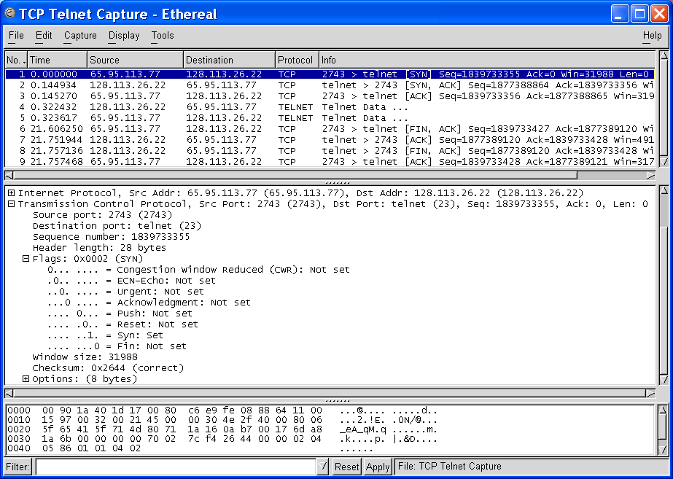
1st Handshake: Client-Server Connection Request
Initial Seq. # from client to server
SYN bit set indicates request to establish connection from client to server

Slide 78
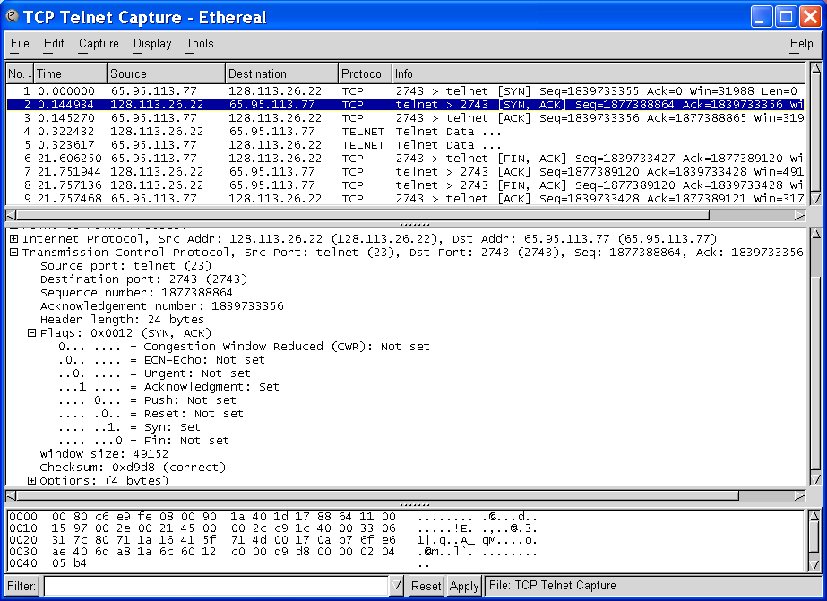
2nd Handshake: ACK from Server
ACK Seq. # = Init. Seq. # + 1
ACK bit set acknowledges connection request; Client-to-Server connection established

Slide 79
2nd Handshake: Server-Client Connection Request
Initial Seq. # from server to client
SYN bit set indicates request to establish connection from server to client

Slide 80
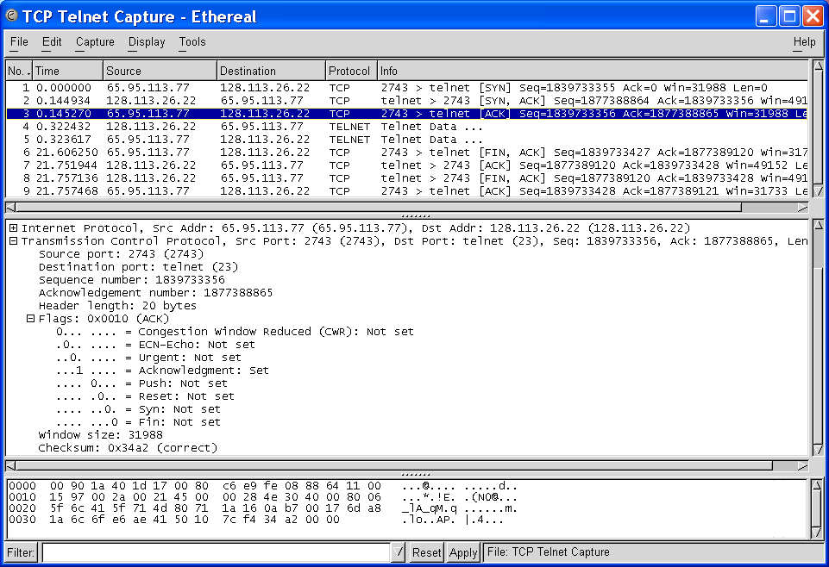
3rd Handshake: ACK from Client
ACK Seq. # = Init. Seq. # + 1
ACK bit set acknowledges connection request; Connections in both directions established

Slide 81
TCP Data Exchange
Application Layers write bytes into buffers
TCP sender forms segments
  When bytes exceed threshold or timer expires
  Upon PUSH command from applications
  Consecutive bytes from buffer inserted in payload
  Sequence # & ACK # inserted in header
  Checksum calculated and included in header
TCP receiver
  Performs selective repeat ARQ functions
  Writes error-free, in-sequence bytes to receive buffer

Slide 82
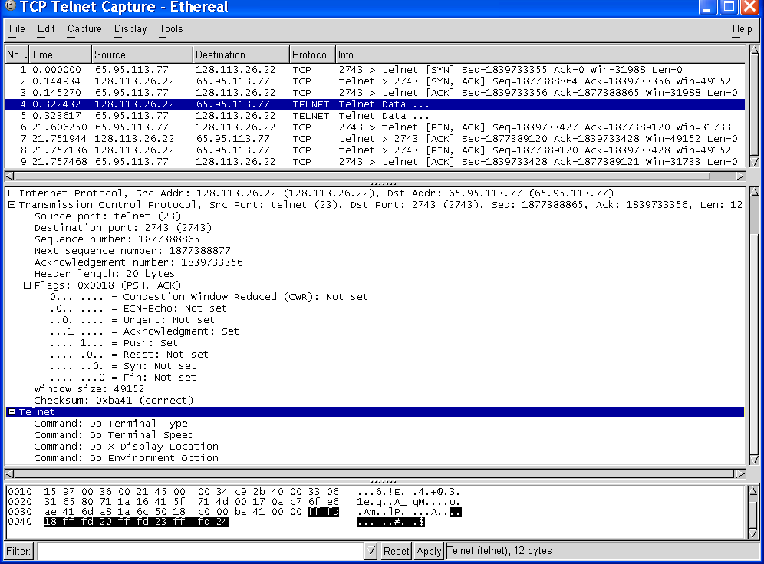
Data Transfer: Server-to-Client Segment
12 bytes of payload
Push set
12 bytes of payload carries telnet option negotiation

Slide 83
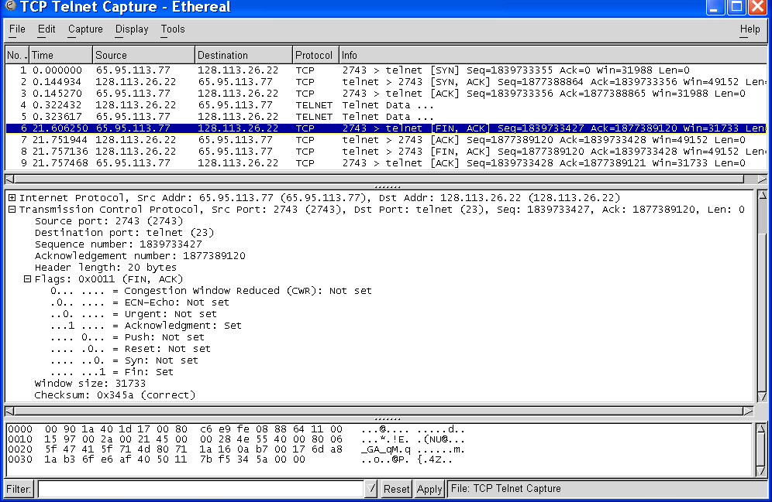
Graceful Close: Client-to-Server Connection
Client initiates closing of its connection to server

Slide 84
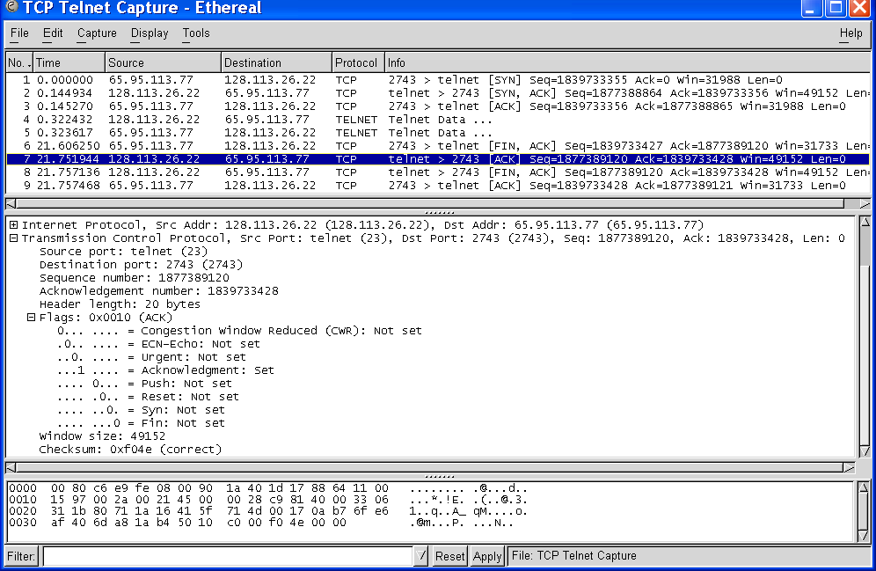
Graceful Close: Client-to-Server Connection
ACK Seq. # = Previous Seq. # + 1
Server ACKs request; client-to-server connection closed

Slide 85
Flow Control
TCP receiver controls rate at which sender transmits to prevent buffer overflow
TCP receiver advertises a window size specifying number of bytes that can be accommodated by receiver
W_{A} = W_{R} – (R_{new –} R_{last})
TCP sender obliged to keep # outstanding bytes below W_{A}
(S_{recent} - S_{last}) ≤ W_{A}
Send Window
Receive Window
S_{last} + W_{A}-1
W_{A}
...
...
...
S_{last}
S_{last} + W_{s} – 1
R_{last}
R_{new}
R_{last} + W_{R} – 1
S_{recent}

Slide 86
TCP window flow control
Host A
Host B
t₀
Seq_no = 1, Ack_no = 2000, Win = 2048, No Data
t₁
Seq_no = 2000, Ack_no = 1, Win = 1024, Data = 2000-3023
t₂
Seq_no = 3024, Ack_no = 1, Win = 1024, Data = 3024-4047
Seq_no = 1, Ack_no = 4048, Win = 512, Data = 1-128
t₃
t₄
Seq_no = 4048, Ack_no = 129, Win = 1024, Data = 4048-4559

Slide 87
TCP Retransmission Timeout
TCP retransmits a segment after timeout period
  Timeout too short: excessive number of retransmissions
  Timeout too long: recovery too slow
  Timeout depends on RTT: time from when segment is sent to when ACK is received
Round trip time (RTT) in Internet is highly variable
  Routes vary and can change in mid-connection
  Traffic fluctuates
TCP uses adaptive estimation of RTT
  Measure RTT each time ACK received: τ_{n}
  t_{RTT}(new) = α t_{RTT}(old) + (1 – α) τ_{n}
  α = 7/8 typical

Slide 88
RTT Variability
Estimate variance σ² of RTT variation
Estimate for timeout:
  t_{out} = t_{RTT} + k σ_{RTT}
If RTT highly variable, timeout increase accordingly
If RTT nearly constant, timeout close to RTT estimate
Approximate estimation of deviation
    d_{RTT}(new) = β d_{RTT}(old) + (1-β) | τ_{n} - t_{RTT} |
t_{out} = t_{RTT} + 4 d_{RTT}

Slide 89
Chapter 5
Peer-to-Peer Protocols and Data Link Layer
PART II: Data Link Controls
Framing
Point-to-Point Protocol
High-Level Data Link Control
Link Sharing Using Statistical Multiplexing

Slide 90
Data Link Protocols
Packets
Packets
Data Links Services
Framing
Error control
Flow control
Multiplexing
Link Maintenance
Security: Authentication & Encryption
Examples
PPP
HDLC
Ethernet LAN
IEEE 802.11 (Wi Fi) LAN
Data link
layer
Data link
layer
A
Frames
Physical
layer
B
Physical
layer
Directly connected, wire-like
Losses & errors, but no out-of-sequence frames
Applications: Direct Links; LANs; Connections across WANs

Slide 91
Chapter 5
Peer-to-Peer Protocols and Data Link Layer
Framing

Slide 92
Framing
Mapping stream of physical layer bits into frames
Mapping frames into bit stream
Frame boundaries can be determined using:
  Character Counts
  Control Characters
  Flags
  CRC Checks
transmitted
frames
received
frames
Framing
0111110101
0110110111

Slide 93
Character-Oriented Framing
Data to be sent
A
DLE
B
ETX
DLE
STX
E
After stuffing and framing
DLE
STX
A
DLE
DLE
B
ETX
DLE
DLE
STX
E
DLE
ETX
Frames consist of integer number of bytes
  Asynchronous transmission systems using ASCII to transmit printable characters
  Octets with HEX value <20 are nonprintable
Special 8-bit patterns used as control characters
  STX (start of text) = 0x02; ETX (end of text) = 0x03;
Byte used to carry non-printable characters in frame
  DLE (data link escape) = 0x10
  DLE STX (DLE ETX) used to indicate beginning (end) of frame
  Insert extra DLE in front of occurrence of DLE STX (DLE ETX) in frame
  All DLEs occur in pairs except at frame boundaries

Slide 94
Framing & Bit Stuffing
HDLC frame
Flag
Address
Control
Information
FCS
Flag
any number of bits
Frame delineated by flag character
HDLC uses bit stuffing to prevent occurrence of flag 01111110 inside the frame
Transmitter inserts extra 0 after each consecutive five 1s inside the frame
Receiver checks for five consecutive 1s
  if next bit = 0, it is removed
  if next two bits are 10, then flag is detected
  If next two bits are 11, then frame has errors

Slide 95
Example: Bit stuffing & de-stuffing
(a)
Data to be sent
0110111111111100
After stuffing and framing
0111111001101111101111100001111110
(b)
Data received
01111110000111011111011111011001111110
After destuffing and deframing
*000111011111-11111-110*

Slide 96
PPP Frame
Flag
Address
Control
Protocol
Information
CRC
Flag
01111110
1111111
00000011
01111110
integer # of bytes
All stations are to
accept the frame
Unnumbered frame
Specifies what kind of packet is contained in the payload, e.g., LCP, NCP, IP, OSI CLNP, IPX
PPP uses similar frame structure as HDLC, except
  Protocol type field
  Payload contains an integer number of bytes
PPP uses the same flag, but uses byte stuffing
Problems with PPP byte stuffing
  Size of frame varies unpredictably due to byte insertion
  Malicious users can inflate bandwidth by inserting 7D & 7E

Slide 97
Byte-Stuffing in PPP
PPP is character-oriented version of HDLC
Flag is 0x7E (01111110)
Control escape 0x7D (01111101)
Any occurrence of flag or control escape inside of frame is replaced with 0x7D followed by
original octet XORed with 0x20 (00100000)
Data to be sent
41
7D
42
7E
50
70
46
7E
41
7D
5D
42
7D
5E
50
70
46
7E
After stuffing and framing

Slide 98
Generic Framing Procedure
GFP payload area
2
2
2
2
0-60
PLI
cHEC
Type
tHEC
GEH
GFP payload
Payload
length
indicator
Core
header
error
checking
Payload
type
Type
header
error
checking
GFP
extension
headers
GFP
payload
GFP combines frame length indication with CRC
  PLI indicated length of frame, then simply count characters
  cHEC (CRC-16) protects against errors in count field (single-bit error correction + error detection)
GFP designed to operate over octet-synchronous physical layers (e.g. SONET)
  Frame-mapped mode for variable-length payloads: Ethernet
  Transparent mode carries fixed-length payload: storage devices

Slide 99
GFP Synchronization & Scrambling
Synchronization in three-states
  Hunt state: examine 4-bytes to see if CRC ok
    If no, move forward by one-byte
    If yes, move to pre-sync state
  Pre-sync state: tentative PLI indicates next frame
    If N successful frame detections, move to sync state
    If no match, go to hunt state
  Sync state: normal state
    Validate PLI/cHEC, extract payload, go to next frame
    Use single-error correction
    Go to hunt state if non-correctable error
Scrambling
  Payload is scrambled to prevent malicious users from inserting long strings of 0s which cause SONET equipment to lose bit clock synchronization (as discussed in line code section)

Slide 100
Chapter 5
Peer-to-Peer Protocols and Data Link Layer
Point-to-Point Protocol

Slide 101
PPP: Point-to-Point Protocol
Data link protocol for point-to-point lines in Internet
  Router-router; dial-up to router
1. Provides Framing and Error Detection
  Character-oriented HDLC-like frame structure
2. Link Control Protocol
  Bringing up, testing, bringing down lines; negotiating options
  Authentication: key capability in ISP access
3. A family of Network Control Protocols specific to different network layer protocols
  IP, OSI network layer, IPX (Novell), Appletalk

Slide 102
PPP Applications
PPP used in many point-to-point applications
Telephone Modem Links 30 kbps
Packet over SONET 600 Mbps to 10 Gbps
  IP→PPP→SONET
PPP is also used over shared links such as Ethernet to provide LCP, NCP, and authentication features
  PPP over Ethernet (RFC 2516)
  Used over DSL

Slide 103
PPP Frame Format
1 or 2
variable
2 or 4
Flag
Address
Control
Protocol
Information
FCS
Flag
01111110
1111111
00000011
01111110
CRC 16 or CRC 32
All stations are to
accept the frame
HDLC Unnumbered frame
PPP can support multiple network protocols simultaneously
Specifies what kind of packet is contained in the payload
  e.g. LCP, NCP, IP, OSI CLNP, IPX...

Slide 104
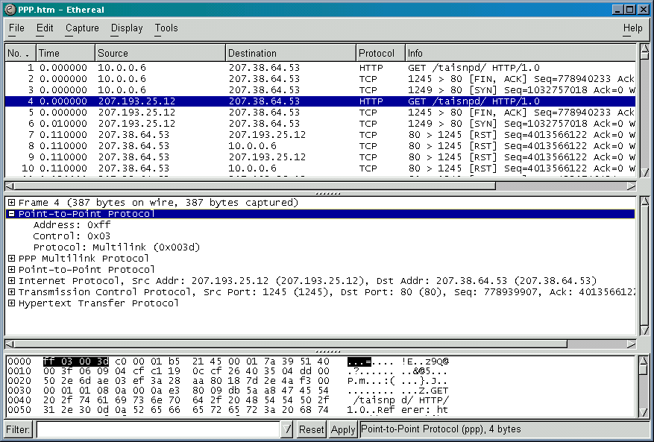
PPP Example

Slide 105
PPP Phases
1. Carrier
detected
Home PC to Internet Service Provider
1. PC calls router via modem
2. PC and router exchange LCP packets to negotiate PPP parameters
3. Check on identities
4. NCP packets exchanged to configure the network layer, e.g. TCP/IP ( requires IP address assignment)
5. Data transport, e.g. send/receive IP packets
6. NCP used to tear down the network layer connection (free up IP address); LCP used to shut down data link layer connection
7. Modem hangs up
Dead
7. Carrier
dropped
Failed
Terminate
Establish
2. Options
negotiated
6. Done
Failed
5.
Open
Authenticate
3. Authentication
completed
4. NCP
configuration
Network

Slide 106
PPP Authentication
Password Authentication Protocol
  Initiator must send ID & password
  Authenticator replies with authentication success/fail
  After several attempts, LCP closes link
  Transmitted unencrypted, susceptible to eavesdropping
Challenge-Handshake Authentication Protocol (CHAP)
  Initiator & authenticator share a secret key
  Authenticator sends a challenge (random # & ID)
  Initiator computes cryptographic checksum of random # & ID using the shared secret key
  Authenticator also calculates cryptocgraphic checksum & compares to response
  Authenticator can reissue challenge during session

Slide 107
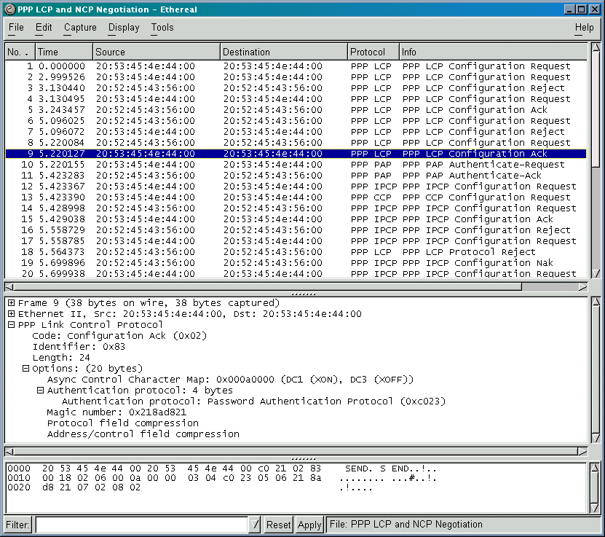
Example: PPP connection setup in dialup modem to ISP
LCP
Setup
PAP
IP NCP
setup

Slide 108
Chapter 5
Peer-to-Peer Protocols and Data Link Layer
High-Level Data Link Control

Slide 109
High-Level Data Link Control (HDLC)
Bit-oriented data link control
Derived from IBM Synchronous Data Link Control (SDLC)
Related to Link Access Procedure Balanced (LAPB)
  LAPD in ISDN
  LAPM in cellular telephone signaling

Slide 110
Network
layer
NLPDU
Network
layer
“Packet”
DLSDU
DLSAP
DLSAP
DLSDU
Data link
layer
DLPDU
Data link
layer
“Frame”
Physical
layer
Physical
layer

Slide 111
HDLC Data Transfer Modes
Normal Response Mode
  Used in polling multidrop lines
Commands
Primary
Responses
Secondary
Secondary
Secondary
Asynchronous Balanced Mode
  Used in full-duplex point-to-point links
Primary
Commands
Responses
Secondary
Secondary
Responses
Commands
Primary
Mode is selected during connection establishment

Slide 112
HDLC Frame Format
Flag
Address
Control
Information
FCS
Flag
Control field gives HDLC its functionality
Codes in fields have specific meanings and uses
  Flag: delineate frame boundaries
  Address: identify secondary station (1 or more octets)
    In ABM mode, a station can act as primary or secondary so address changes accordingly
  Control: purpose & functions of frame (1 or 2 octets)
  Information: contains user data; length not standardized, but implementations impose maximum
  Frame Check Sequence: 16- or 32-bit CRC

Slide 113
Control Field Format
Information Frame
1
2-4
5
6-8
0
N(S)
P/F
N(R)
Supervisory Frame
1
0
S
S
P/F
N(R)
Unnumbered Frame
1
1
M
M
P/F
M
M
M
S: Supervisory Function Bits
N(R): Receive Sequence Number
N(S): Send Sequence Number
M: Unnumbered Function Bits
P/F: Poll/final bit used in interaction between primary and secondary

Slide 114
Information frames
Each I-frame contains sequence number N(S)
Positive ACK piggybacked
  N(R)=Sequence number of next frame expected acknowledges all frames up to and including N(R)-1
3 or 7 bit sequence numbering
  Maximum window sizes 7 or 127
Poll/Final Bit
  NRM: Primary polls station by setting P=1; Secondary sets F=1 in last I-frame in response
  Primaries and secondaries always interact via paired P/F bits

Slide 115
Error Detection & Loss Recovery
Frames lost due to loss-of-synch or receiver buffer overflow
Frames may undergo errors in transmission
CRCs detect errors and such frames are treated as lost
Recovery through ACKs, timeouts & retransmission
Sequence numbering to identify out-of-sequence & duplicate frames
HDLC provides for options that implement several ARQ methods

Slide 116
Supervisory frames
Used for error (ACK, NAK) and flow control (Don’t Send):
Receive Ready (RR), SS=00
  ACKs frames up to N(R)-1 when piggyback not available
REJECT (REJ), SS=01
  Negative ACK indicating N(R) is first frame not received correctly. Transmitter must resend N(R) and later frames
Receive Not Ready (RNR), SS=10
  ACKs frame N(R)-1 & requests that no more I-frames be sent
Selective REJECT (SREJ), SS=11
  Negative ACK for N(R) requesting that N(R) be selectively retransmitted

Slide 117
Unnumbered Frames
Setting of Modes:
  SABM: Set Asynchronous Balanced Mode
  UA: acknowledges acceptance of mode setting commands
  DISC: terminates logical link connectio
Information Transfer between stations
  UI: Unnumbered information
Recovery used when normal error/flow control fails
  FRMR: frame with correct FCS but impossible semantics
  RSET: indicates sending station is resetting sequence numbers
XID: exchange station id and characteristics

Slide 118
Connection Establishment & Release
Supervisory frames used to establish and release data link connection
In HDLC
  Set Asynchronous Balanced Mode (SABM)
  Disconnect (DISC)
  Unnumbered Acknowledgment (UA)
SABM
Data
transfer
UA
UA
DISC

Slide 119
Example: HDLC using NRM (polling)
Address of secondary
Primary A
Secondaries B, C
A polls B
B, RR, 0, P
N(S)
N(R)
B, I, 0, 0
B sends 3 info
frames
N(R)
B, I, 1, 0
X
B, I, 2, 0,F
A rejects fr1
B, SREJ, 1
A polls C
C, RR, 0, P
C, RR, 0, F
C nothing to send
A polls B, requests
selective retrans. fr1
B, SREJ, 1,P
B, I, 1, 0
B resends fr1
Then fr 3 & 4
B, I, 3, 0
B, I, 4, 0, F
A send info fr0
to B, ACKs up to 4
B, I, 0, 5
Time

Slide 120
Frame Exchange using Asynchronous Balanced Mode
Combined Station A
Combined Station B
B, I, 0, 0
A, I, 0, 0
B, I, 1, 0
A, I, 1, 1
A ACKs fr0
X
B sends 5 frames
B, I, 2, 1
A, I, 2, 1
B, I, 3, 2
A rejects fr1
B, REJ, 1
B, I, 4, 3
A, I, 3, 1
B goes back to 1
B, I, 1, 3
B, I, 2, 4
B, RR, 2
A ACKs fr1
B, I, 3, 4
B, RR, 3
A ACKs fr2

Slide 121
Flow Control
Flow control is required to prevent transmitter from overrunning receiver buffers
Receiver can control flow by delaying acknowledgement messages
Receiver can also use supervisory frames to explicitly control transmitter
  Receive Not Ready (RNR) & Receive Ready (RR)
I3
I4
I5
RNR5
RR6
I6

Slide 122
Chapter 5
Peer-to-Peer Protocols and Data Link Layer
Link Sharing Using Statistical Multiplexing

Slide 123
Statistical Multiplexing
Multiplexing concentrates bursty traffic onto a shared line
Greater efficiency and lower cost
Header Data payload
A
B
Buffer
Output line
C
Input lines

Slide 124
Tradeoff Delay for Efficiency
(a)
Dedicated lines
A₁
A₂
B₁
B₂
C₁
C₂
(b)
Shared lines
A₁
C₁
B₁
A₂
B₂
C₂
Dedicated lines involve not waiting for other users, but lines are used inefficiently when user traffic is bursty
Shared lines concentrate packets into shared line; packets buffered (delayed) when line is not immediately available

Slide 125
Multiplexers inherent in Packet Switches
1
1
2
2
●
●
●
●
●
●
N
N
Packets/frames forwarded to buffer prior to transmission from switch
Multiplexing occurs in these buffers

Slide 126
Multiplexer Modeling
Input lines
A
Output line
B
Buffer
C
Arrivals: What is the packet interarrival pattern?
Service Time: How long are the packets?
Service Discipline: What is order of transmission?
Buffer Discipline: If buffer is full, which packet is dropped?
Performance Measures:
Delay Distribution; Packet Loss Probability; Line Utilization

Slide 127
Delay = Waiting + Service Times
P1
P2
P3
P4
P5
Packet completes
transmission
Service
time
Packet begins
transmission
Waiting
time
Packet arrives
at queue
P1
P2
P3
P4
P5
Packets arrive and wait for service
Waiting Time: from arrival instant to beginning of service
Service Time: time to transmit packet
Delay: total time in system = waiting time + service time

Slide 128
Fluctuations in Packets in the System
(a)
Dedicated lines
A₁
A₂
B₁
B₂
C₁
C₂
(b)
Shared line
A₁
C₁
B₁
A₂
B₂
C₂
(c)
N(t)
Number of packets in the system

Slide 129
Packet Lengths & Service Times
R bits per second transmission rate
L = # bits in a packet
X = L/R = time to transmit (“service”) a packet
Packet lengths are usually variable
  Distribution of lengths → Dist. of service times
  Common models:
    Constant packet length (all the same)
    Exponential distribution
    Internet Measured Distributions fairly constant
      See next chart

Slide 130
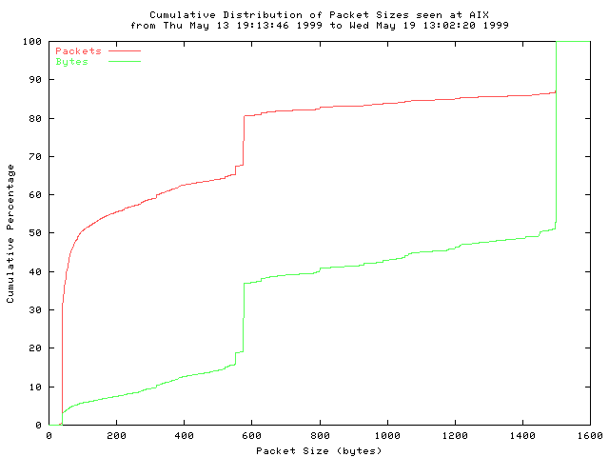
Measure Internet Packet Distribution
Dominated by TCP traffic (85%)
~40% packets are minimum-sized 40 byte packets for TCP ACKs
~15% packets are maximum-sized Ethernet 1500 frames
~15% packets are 552 & 576 byte packets for TCP implementations that do not use path MTU discovery
Mean=413 bytes
Stand Dev=509 bytes
Source: caida.org

Slide 131
M/M/1/K Queueing Model
Exponential service
time with rate μ
K – 1 buffer
Poisson Arrivals
rate λ
At most K customers allowed in system
1 customer served at a time; up to K – 1 can wait in queue
Mean service time E[X] = 1/μ
Key parameter Load: ρ = λ/μ
When λ << μ (ρ≈0), customers arrive infrequently and usually find system empty, so delay is low and loss is unlikely
As λ approaches μ (ρ→1) , customers start bunching up and delays increase and losses occur more frequently
When λ > μ (ρ>0) , customers arrive faster than they can be processed, so most customers find system full and those that do enter have to wait about K – 1 service times

Slide 132
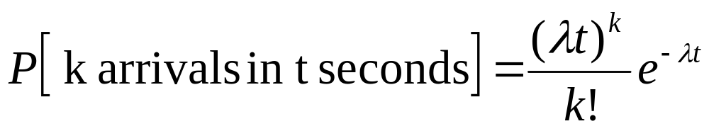
Poisson Arrivals
Average Arrival Rate: λ packets per second
Arrivals are equally-likely to occur at any point in time
Time between consecutive arrivals is an exponential random variable with mean 1/ λ
Number of arrivals in interval of time t is a Poisson random variable with mean λt

Slide 133
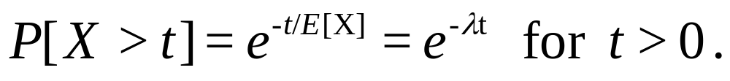
Exponential Distribution
Probability density
1-e^{-λt}
P[X<t]
λe^{-λt}
t
t
0
0

Slide 134
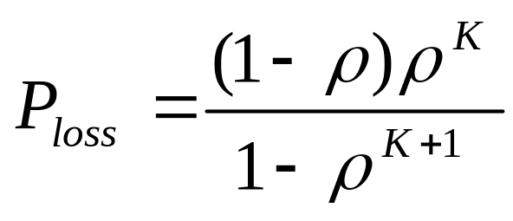
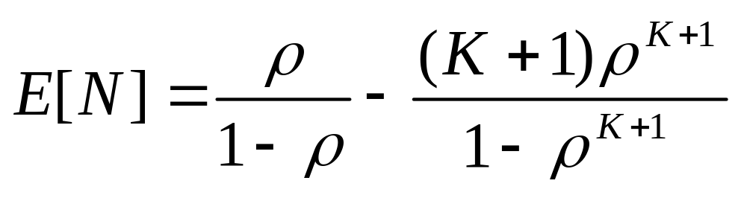
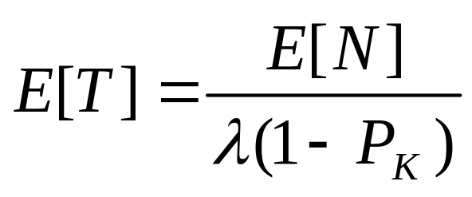
M/M/1/K Performance Results
(From Appendix A)
Probability of Overflow:
Average Total Packet Delay:

Slide 135
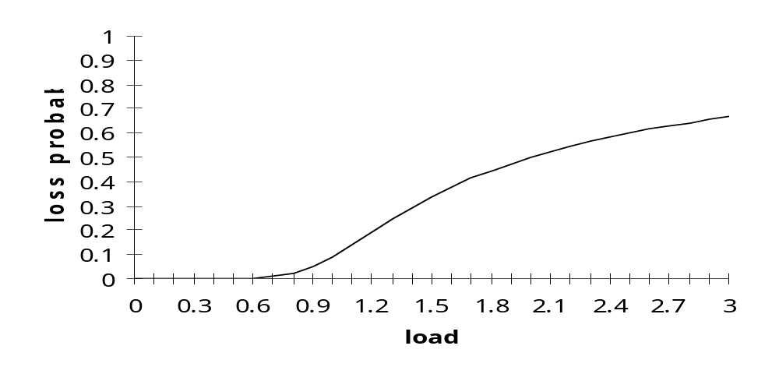
M/M/1/10
10
9
Maximum 10 packets allowed in system
Minimum delay is 1 service time
Maximum delay is 10 service times
At 70% load delay & loss begin increasing
What if we add more buffers?
8
E[T]/E[X]
7
6
normalized avg delay
5
4
3
2
1
0
0
0.2
0.4
0.6
0.8
1
1.2
1.4
1.6
1.8
2
2.2
2.4
2.6
2.8
3
load
loss probability

Slide 136
M/M/1 Queue
Infinite buffer
Exponential service
time with rate μ
Poisson Arrivals
rate λ
Unlimited number of customers allowed in system
P_{b}=0 since customers are never blocked
Average Time in system E[T] = E[W] + E[X]
When λ << μ, customers arrive infrequently and delays are low
As λ approaches μ  customers start bunching up and average delays increase
When λ > μ  customers arrive faster than they can be processed and queue grows without bound (unstable)

Slide 137
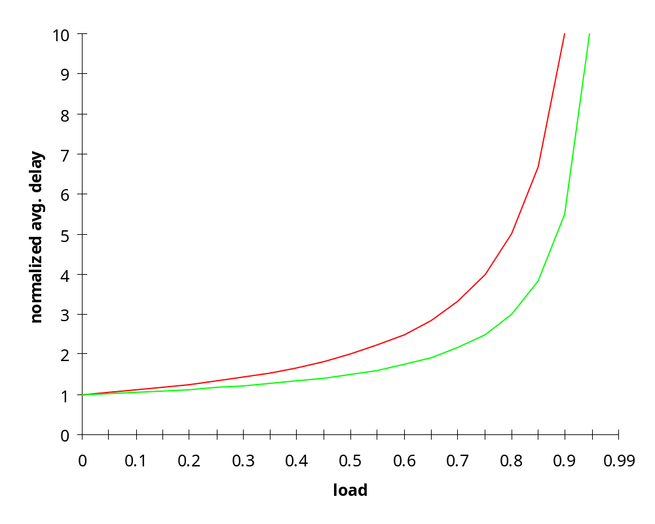
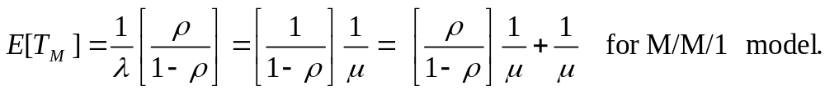
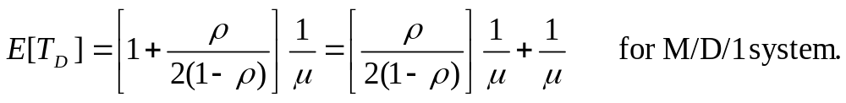
Avg. Delay in M/M/1 & M/D/1
normalized average delay
M/M/1
constant service time
M/D/1

Slide 138
Effect of Scale
C = 100,000 bps
Exp. Dist. with Avg. Packet Length: 10,000 bits
Service Time: X=0.1 second
Arrival Rate: 7.5 pkts/sec
Load: ρ=0.75
Mean Delay:
E[T] = 0.1/(1-.75) = 0.4 sec
C = 10,000,000 bps
Exp. Dist. with Avg. Packet Length: 10,000 bits
Service Time: X=0.001 second
Arrival Rate: 750 pkts/sec
Load: ρ=0.75
Mean Delay:
E[T] = 0.001/(1-.75) = 0.004 sec
Reduction by factor of 100
Aggregation of flows can improve Delay & Loss Performance

Slide 139
Example: Header overhead & Goodput
Let R=64 kbps
Assume IP+TCP header = 40 bytes
Assume constant packets of total length
  L= 200, 400, 800, 1200 bytes
Find avg. delay vs. goodput (information transmitted excluding header overhead)
Service rate μ = 64000/8L packets/second
Total load ρ = λ 64000/8L
Goodput = λ packets/sec x 8(L-40) bits/packet
Max Goodput = (1-40/L)64000 bps

Slide 140
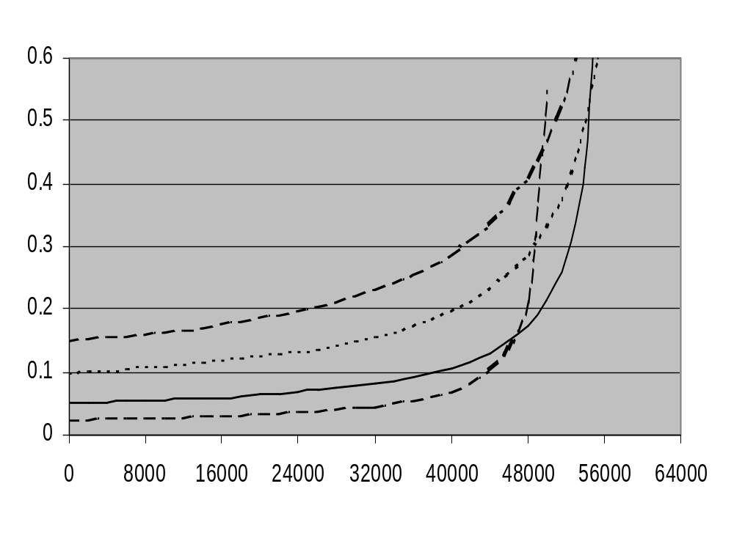
Header overhead limits maximum goodput
L=1200
Average Delay (seconds)
L=800
L=400
L=200
Goodput (bits/second)

Slide 141
Burst Multiplexing / Speech Interpolation
Many
Voice
Calls
Fewer
Trunks
Part of this burst is lost
Voice active < 40% time
No buffering, on-the-fly switch bursts to available trunks
Can handle 2 to 3 times as many calls
Tradeoff: Trunk Utilization vs. Speech Loss
  Fractional Speech Loss: fraction of active speech lost
Demand Characteristics
  Talkspurt and Silence Duration Statistics
  Proportion of time speaker active/idle

Slide 142
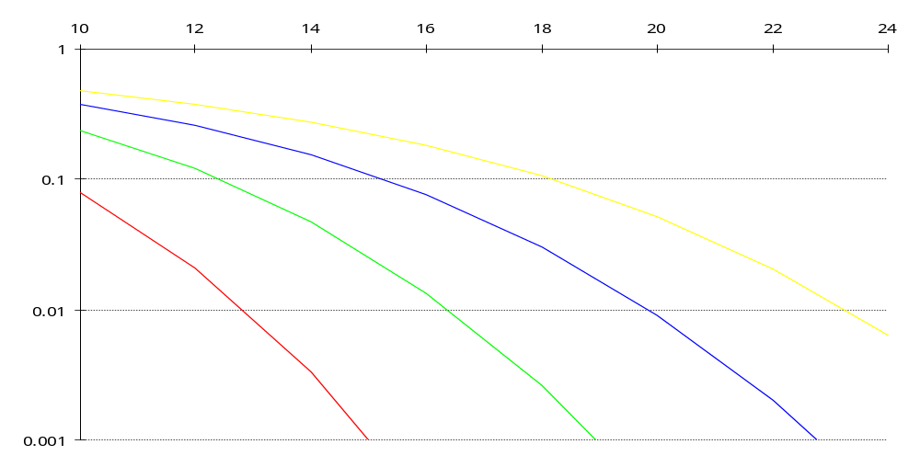
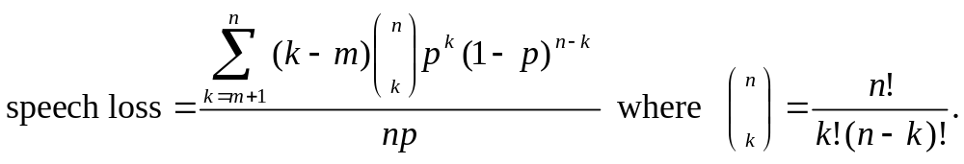
Speech Loss vs. Trunks
trunks
speech loss
Typical requirement
48
24
32
40
# connections

Slide 143
Effect of Scale
Larger flows lead to better performance
Multiplexing Gain = # speakers / # trunks
Trunks required for 1% speech loss
Speakers | Trunks | Multiplexing Gain | Utilization
24 | 13 | 1.85 | 0.74
32 | 16 | 2.00 | 0.80
40 | 20 | 2.00 | 0.80
48 | 23 | 2.09 | 0.83

Slide 144
Packet Speech Multiplexing
Many voice terminals
generating voice packets
A₃
A₂
A₁
B₃
B₂
B₁
Buffer
B₃
C₃
A₂
D₂
C₂
B₁
C₁
D₁
A₁
C₃
C₂
C₁
D₃
D₂
D₁
Buffer overflow
B₂
Digital speech carried by fixed-length packets
No packets when speaker silent
Synchronous packets when speaker active
Buffer packets & transmit over shared high-speed line
Tradeoffs: Utilization vs. Delay/Jitter & Loss

Slide 145
Packet Switching of Voice
1
2
3
Sent
t
1
2
3
Received
t
Packetization delay: time for speech samples to fill a packet
Jitter: variable inter-packet arrivals at destination
Playback strategies required to compensate for jitter/loss
  Flexible delay inserted to produce fixed end-to-end delay
  Need buffer overflow/underflow countermeasures
  Need clock recovery algorithm

Slide 146
Chapter 5
Peer-to-Peer Protocols and Data Link Layer
ARQ Efficiency Calculations

Slide 147
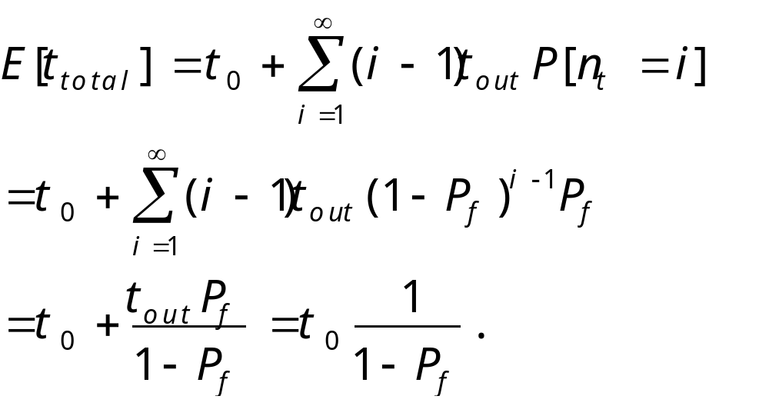
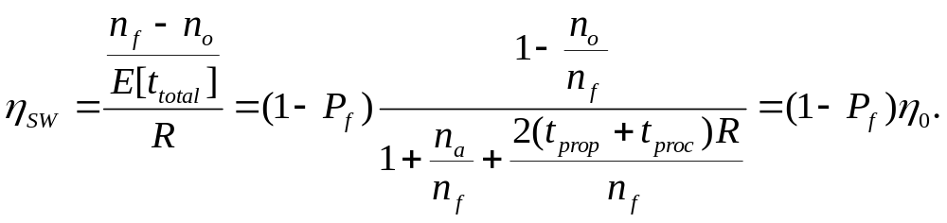
Stop & Wait Performance
1 successful transmission
i – 1 unsuccessful transmissions
Efficiency:

Slide 148
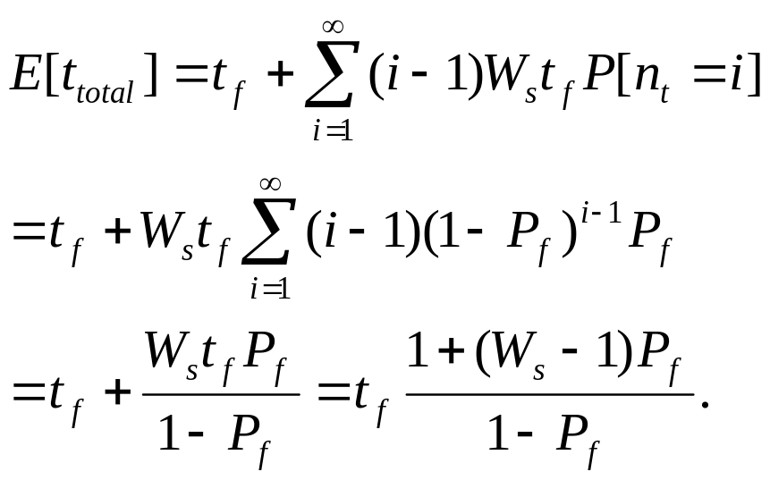
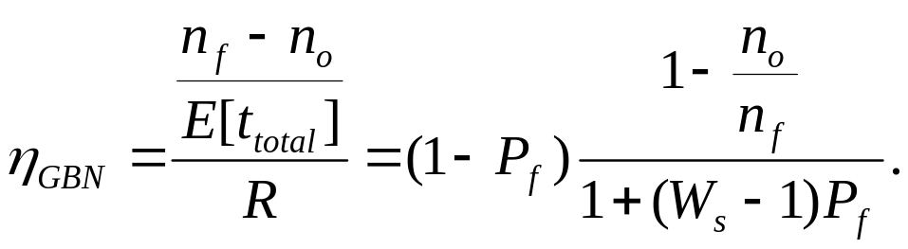
Go-Back-N Performance
1 successful transmission
i – 1 unsuccessful transmissions
Efficiency:

